Slide 1
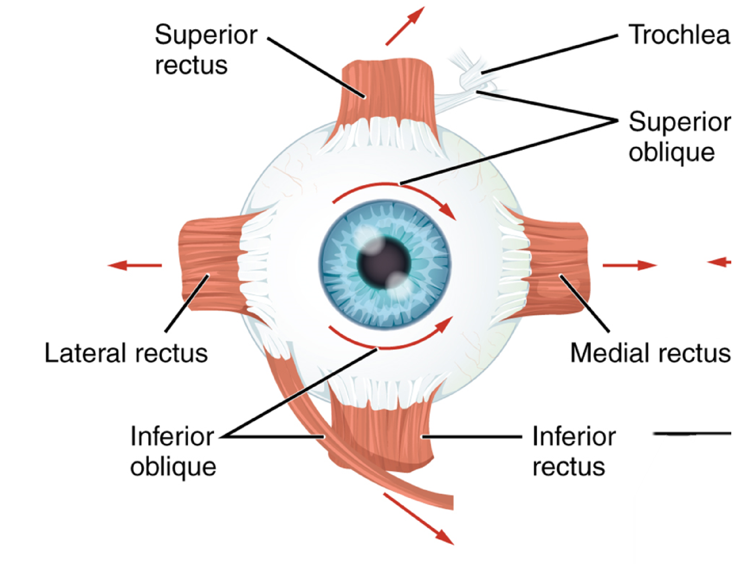

Planes of action of extra-ocular muscle pairs
Plane of superior & inferior obliques
Midline plane
Plane of medial & lateral recti
Plane of superior & inferior recti
Notes:
Extra credit pulleys
Planes of action are fixed in the head so when the eye rotates the eye movement changes

Slide 2
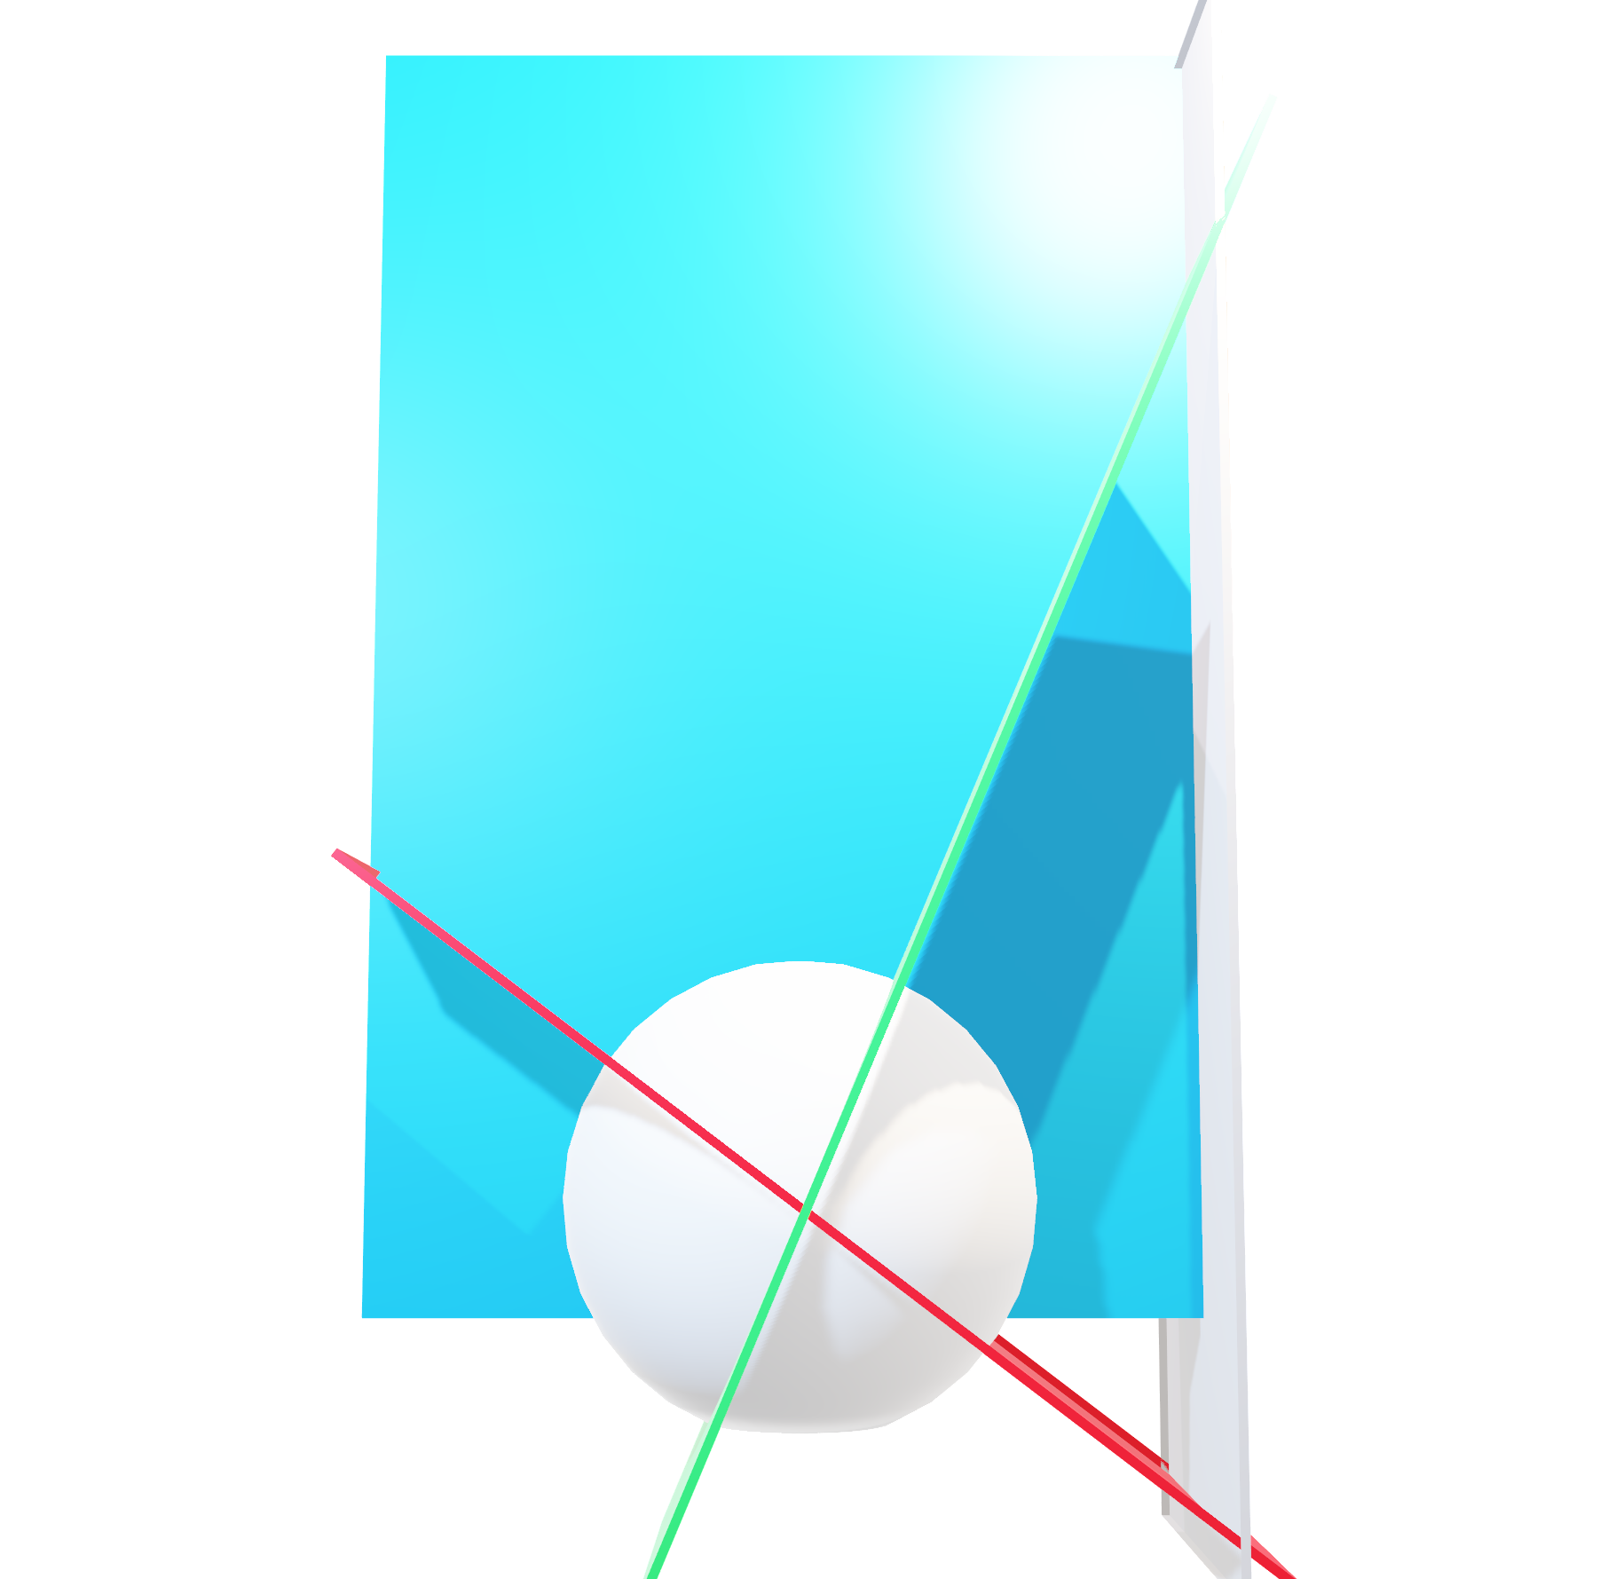
Planes of action of extra-ocular muscle pairs
Plane of superior & inferior obliques
21°
Midline plane
53°
Plane of medial & lateral recti
Plane of superior & inferior recti
Notes:
Extra credit pulleys
Planes of action are fixed in the head so when the eye rotates the eye movement changes

Slide 3



Planes of action of extra-ocular muscle pairs
The Planes of action are fixed to the head*
The eye movements they produce depend on current eye position
For example, the superior & inferior recti can produce pure torsion or pure vertical movements
Looking straight ahead
Looking left
Looking right
Mix vertical torsion
Pure torsion
Pure vertical
*but pulleys…
Notes:
*pulleys

